Slide 1
Big Mountain Resort Analysis
By Gavin Sadecki

Slide 2
How can the resort increase its revenue?
Big Mountain Resort recently built a new chair which increased operating costs by $1,540,000.
Big Mountain Resort believes their ticket price does not accurately reflect the amenities it offers to guests.
How can Big Mountain Resort determine a more accurate ticket price to help bring in revenue to offset the maintenance cost and capitalize further on its amenities?

Slide 3
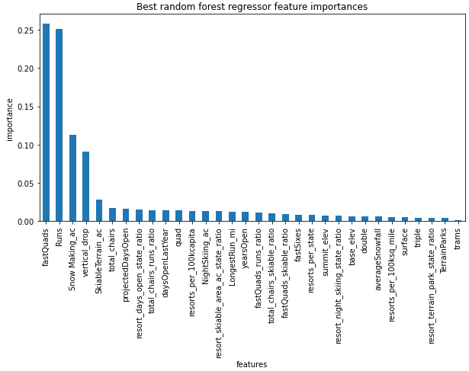
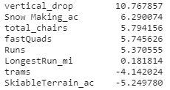
Models Tested
We evaluated two models, linear regression and random forest regressor
Linear regression gives us a mean absolute error of 10.50 with a standard deviation of 1.62
From Linear regression, we can see more emphasis is place on vertical drop, snow making ac and total chairs
RFR gave us an mean absolute error of 9.64 and a standard deviation of 1.35
We can this model places stronger emphasis on fast Quads, runs and snow making ac

Slide 4
Random Forest Regressor
Since RFR has a lower mean error and narrower standard deviation, we will choose this model to determine ticket price
Additionally, we noticed that some of the features important to linear regression also appeared near the top for RFR, although in a different order
After training our model and predicting the price given the features Big Mountain Resort has, the ticket price is predicted to be $95.84

Slide 5
Scenarios
Scenario 1 | Close down 10 runs | Lower ticket price up to $1.82 | Needs Additional Evaluation
Scenario 2 | Add new run Add new chair Increase vert drop by 150 ft | Increase ticket price by $8.61 | Recommend
Scenario 3 | Add new run Add new chair Increase vert drop by 150 ft Increase snow making acreage by 2 | Increase ticket price by $9.90 | Recommend
Scenario 4 | Increase longest run by 0.2 miles Increase snow making acreage by 4 | No change in price | Do Not Recommend

Slide 6
Scenarios
The first scenario will need additional information, depending on how much it costs to keep a run open will determine whether it should be closed or not
The second scenario is recommend, it will increase revenue significantly with minor changes
The third scenario is similar to the second, it is a big bump in ticket price that will help increase revenue
The fourth scenario is not recommended, it incurs costs while not benefitting the ticket price

Slide 7
Recommendations and Findings
Our model found the most important features are the number of fast quads and runs the resort has.
Big Mountain Resort should change its ticket price to $95.84
They should also implement their second scenario they presented and increase ticket prices by an additional $8.61
Both of these changes will increase revenue by $41,037,500 per year on top of what the resort currently makes, assuming 350,000 visitors each staying for 5 days

Slide 8
Conclusion
Using the Random Forest Regressor, we found that it performs better than our Linear Regression model
The RFR model suggests that the current ticket price should be set to $95.81, an increase of $14.81
Using the same model, we see that implementing the changes of the second scenario present to us will increase ticket prices by $8.61
These changes will increase yearly revenue by $25,917,500 and $15,067,500 respectively
The increase in revenue will be more than enough to cover the increase in operating costs of the new chair built and allow the company to pursue further ventures with the remaining amount

